Slide 1
Portland , Or Housing & Affordability

Slide 2
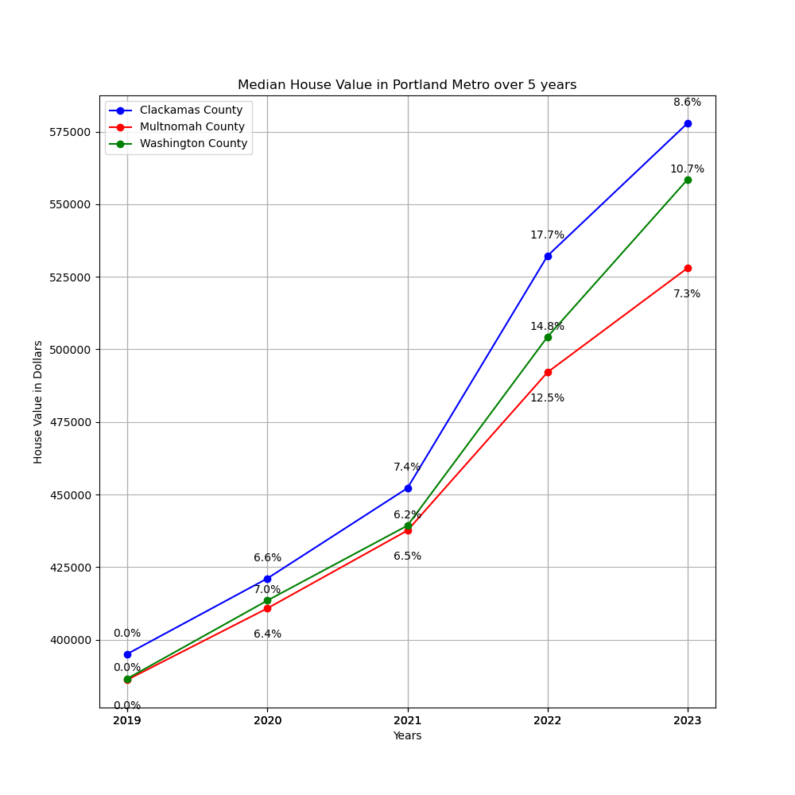
This data shows that over the five year span from 2019-2023 the median home value in Clackamas, Washington, and Multnomah counties saw a significant increase.
Total Increase are as follows:
Clackamas – 40.3%
Washington – 38.7%
Multnomah - 32.7%

Slide 3
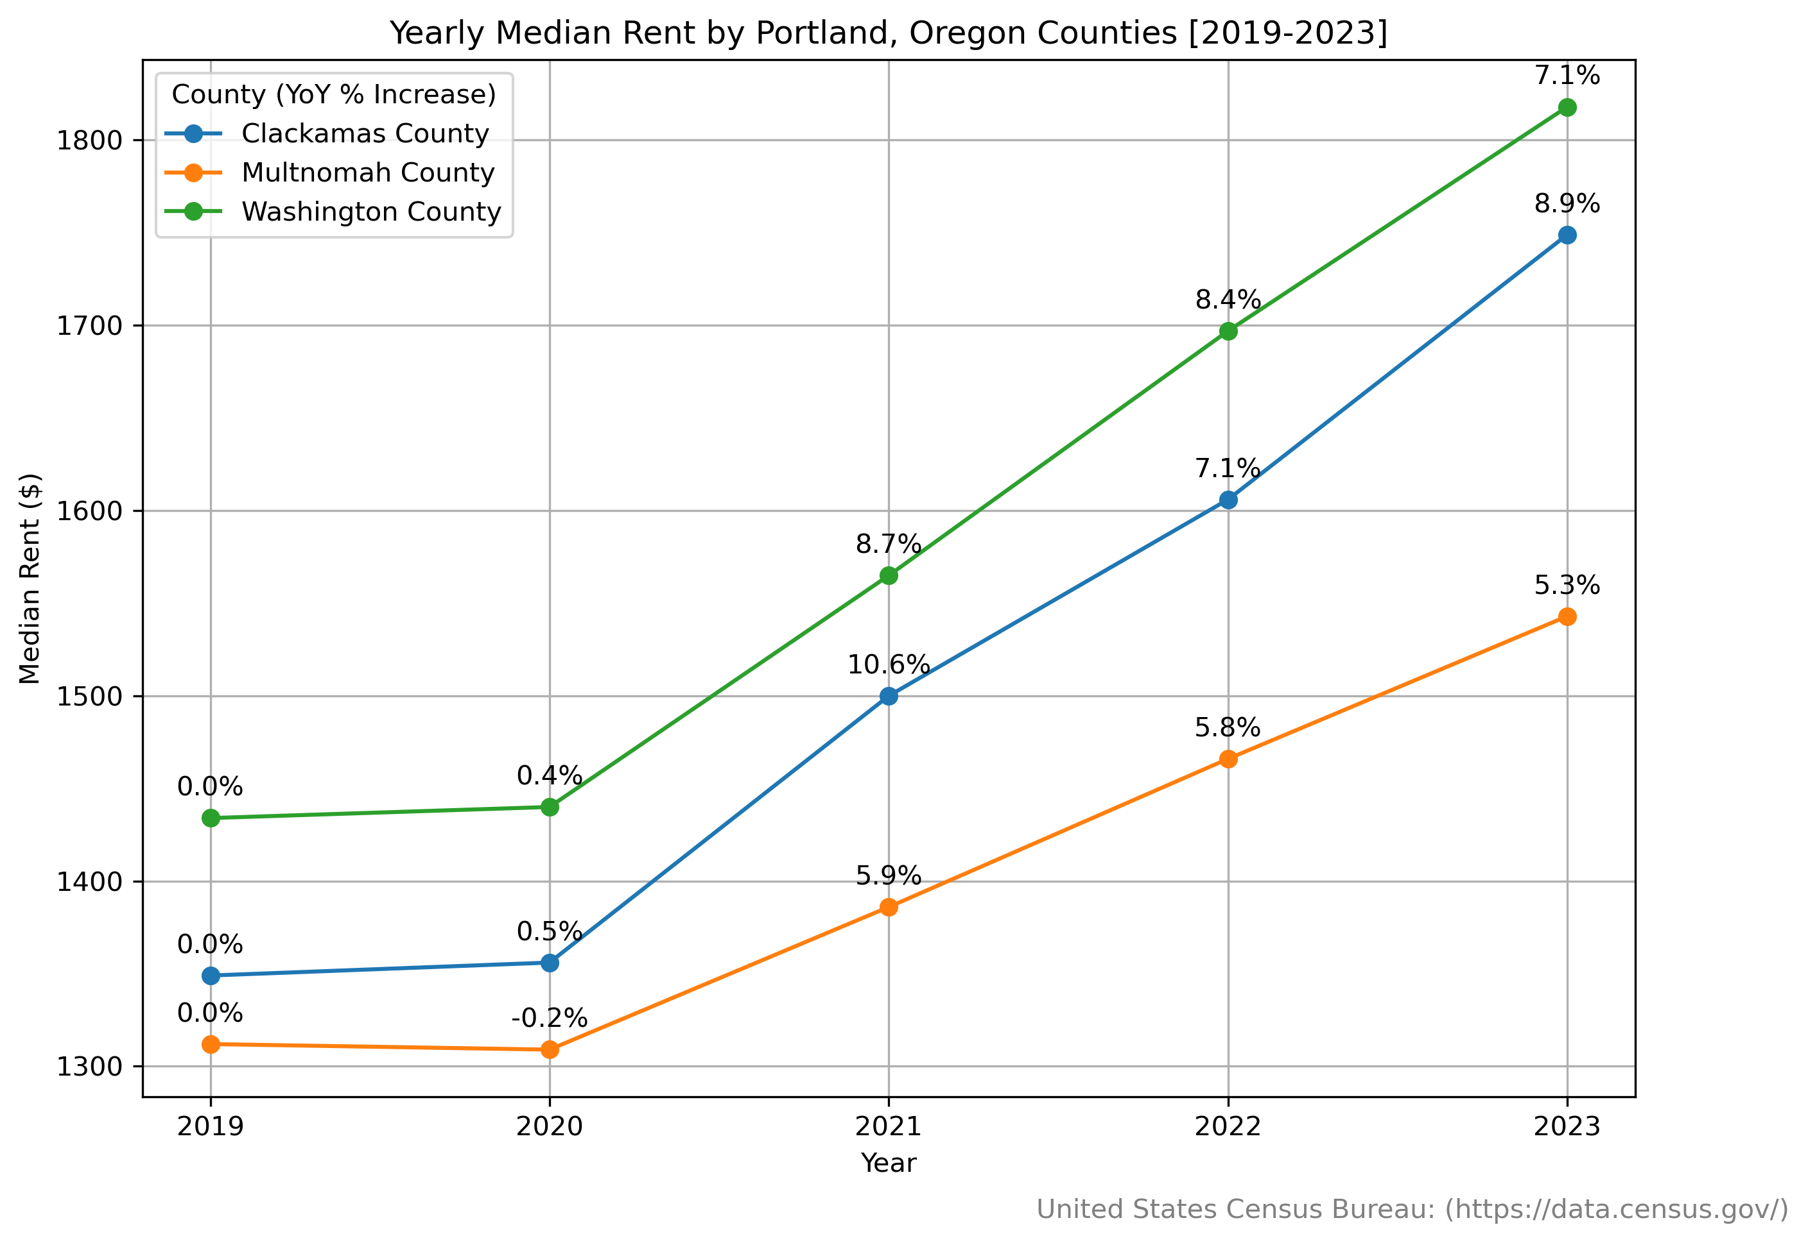

Slide 4
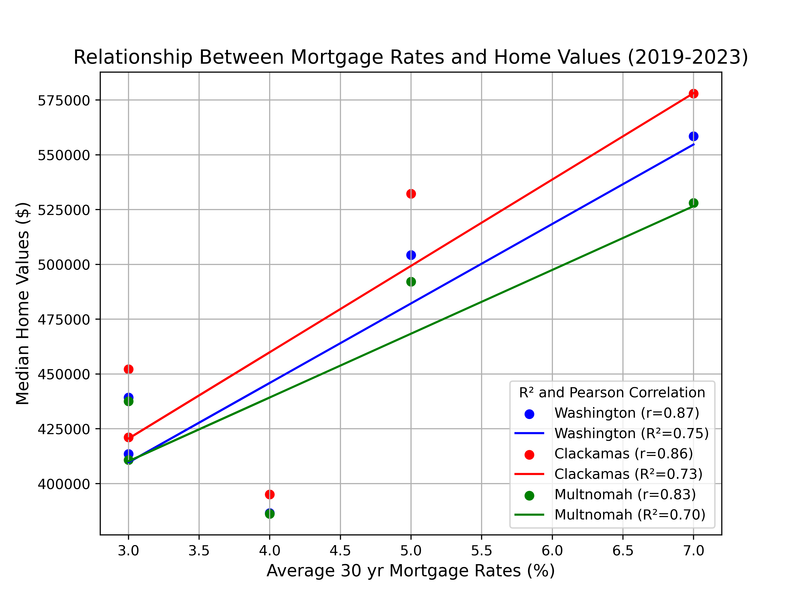

Slide 6
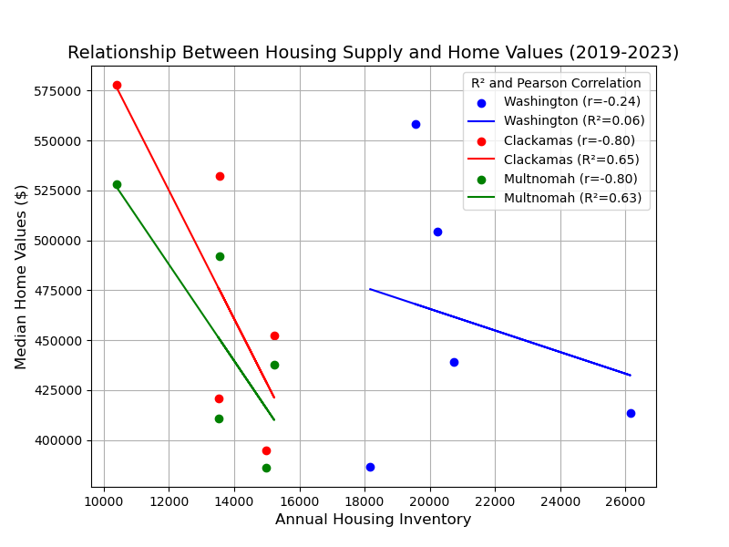
Significant correlation in Clackamas and Multnomah → As inventory decreased, home values rose.
Washington County had almost no relationship (R² = 0.0554), meaning inventory changes did not meaningfully impact home values there.

Slide 7
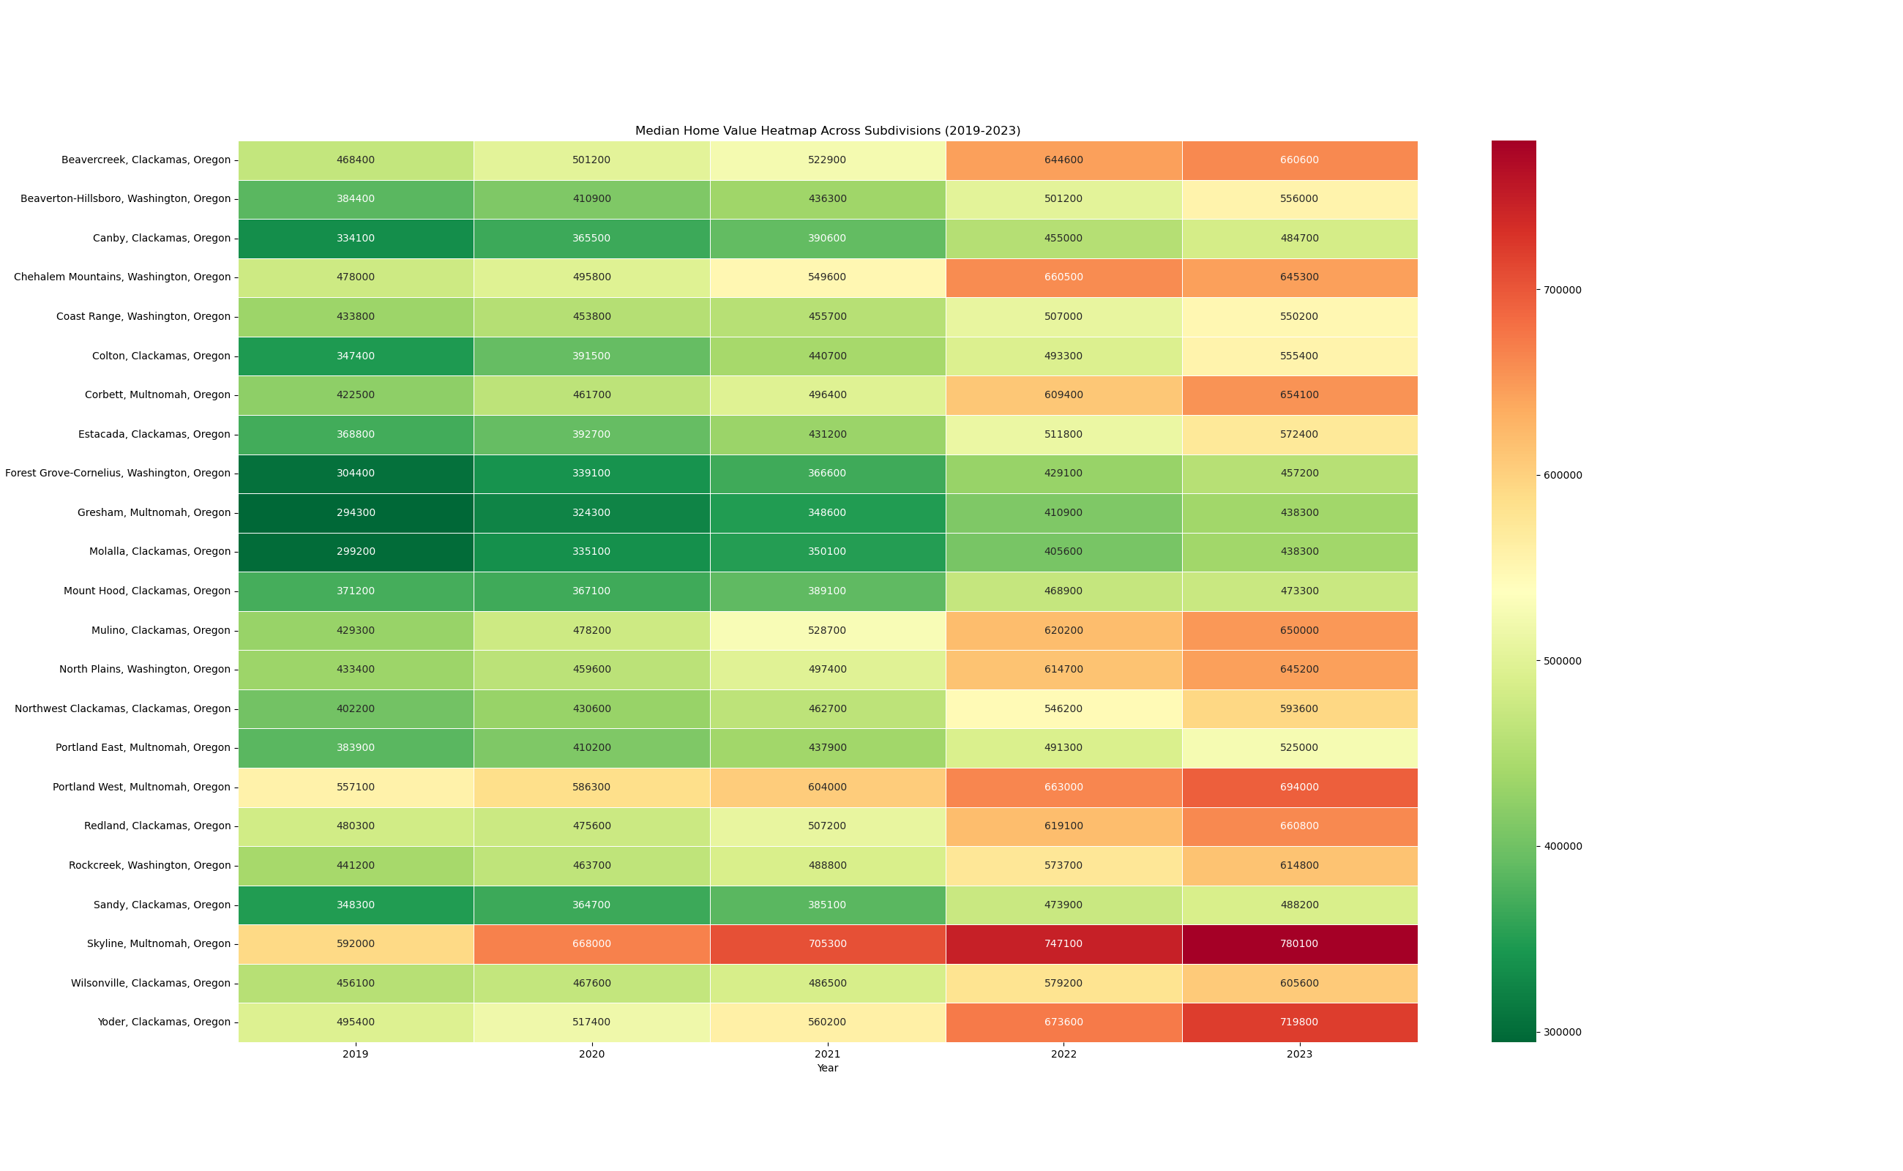

Slide 8
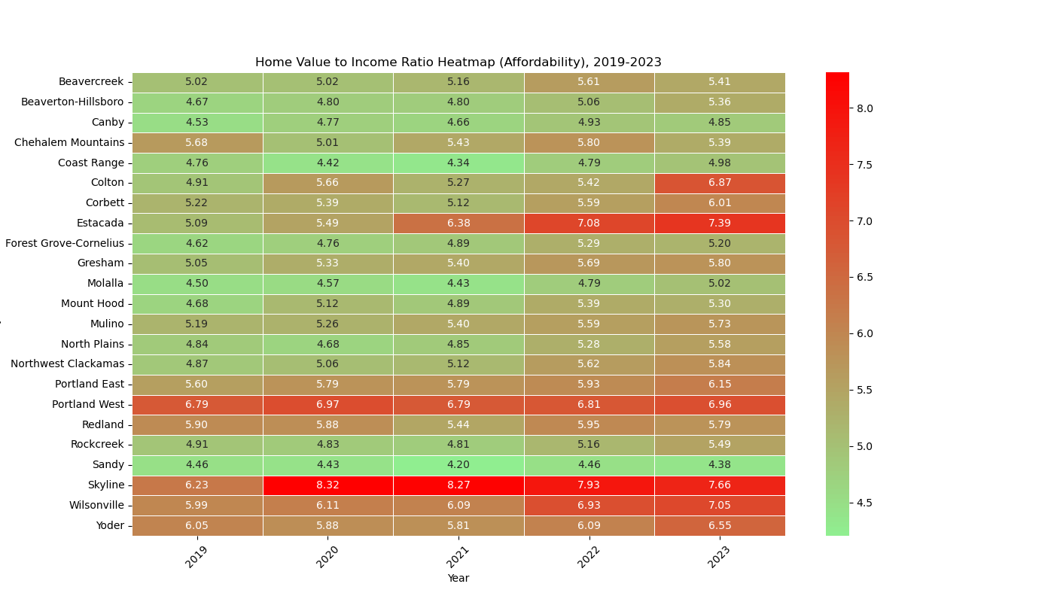

Slide 9
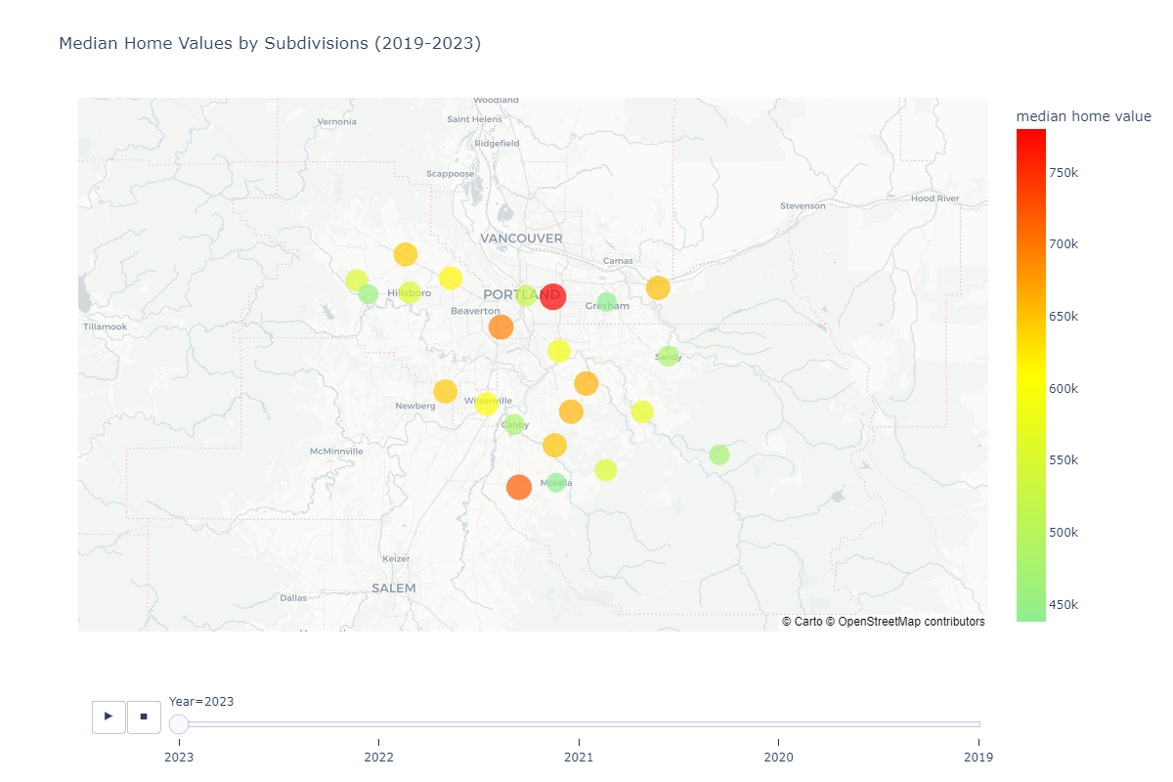

Slide 10
